Slide 17
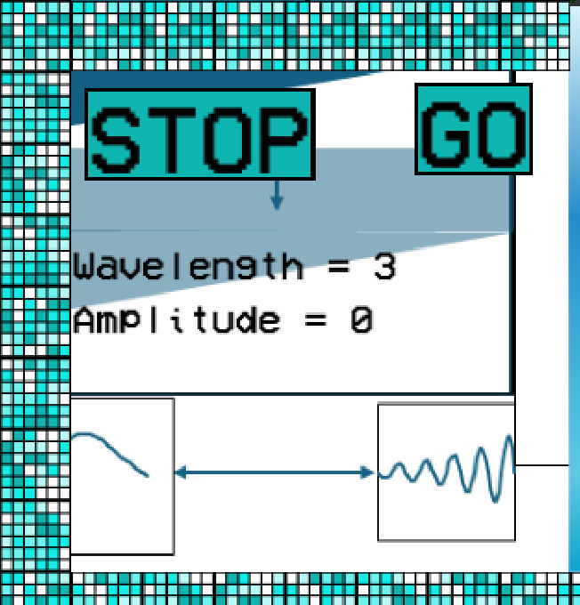
WAVEMACHINE 5000

Slide 18
WAVEMACHINE 5000

Slide 19
WAVEMACHINE 5000

Slide 20
WAVEMACHINE 5000

Slide 21
WAVEMACHINE 5000

Slide 22
WAVEMACHINE 5000

Slide 23
WAVEMACHINE 5000

Slide 24
WAVEMACHINE 5000

Slide 25
WAVEMACHINE 5000

Slide 31
WAVEMAKERS

Slide 32
WAVEMAKERS

Slide 33
WM

Slide 34


Slide 35


Slide 45
Pool noodle

Slide 47
Floaties

Slide 48
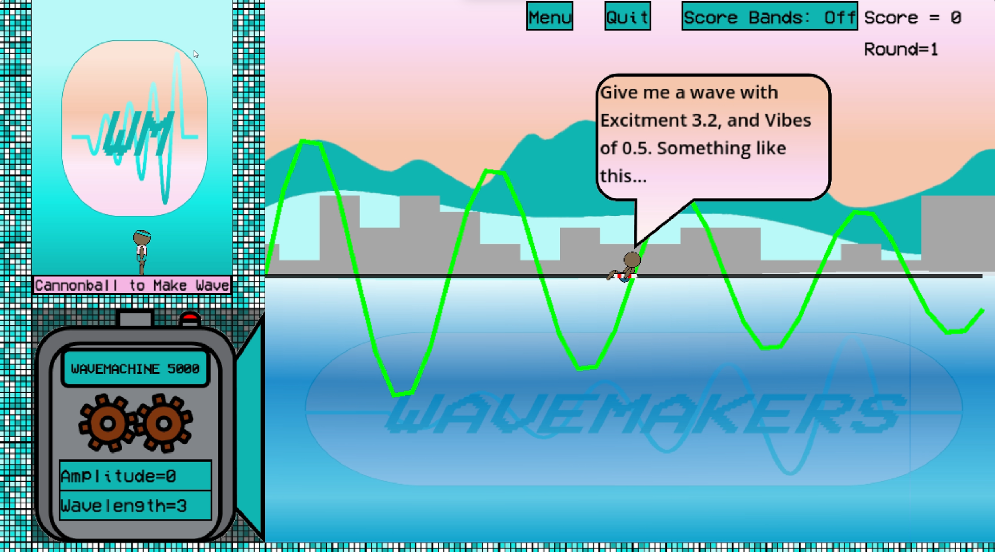
Welcome To Wavemakers Wave Pool!
You are the Wavemaker,and it’s your job to make the wave with a Wavelength and Amplitude that matches the requested wave Vibes and Excitement that the various pool-goers will have. Remember the WAVES formula:
Wavelength*Amplitude-Vibes*Excitement = Score!

Slide 49
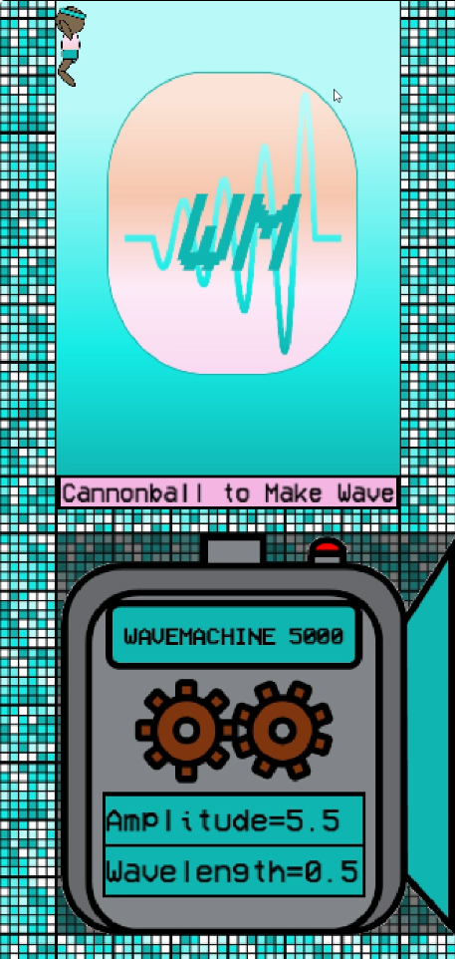
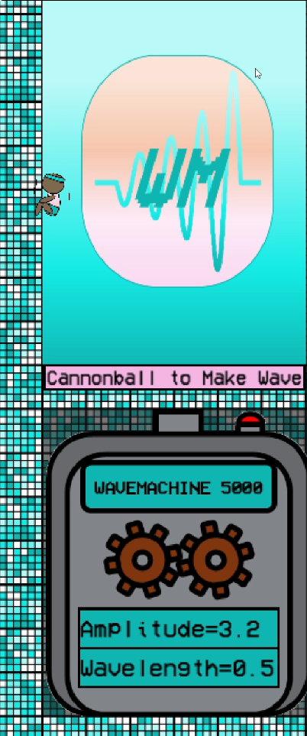
This is you on the left. You can make waves by jumping (Space Bar) and initiating a cannonball (Space Bar when in the Air).
Jump with Space Bar!
Cannonball with Space Bar after a Jump!

Slide 50
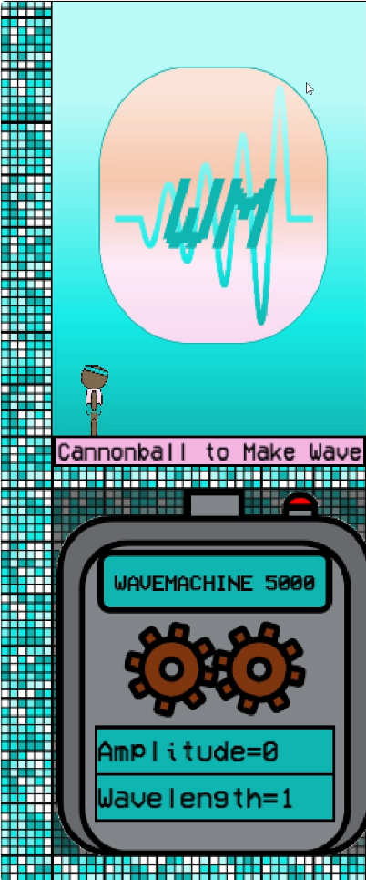
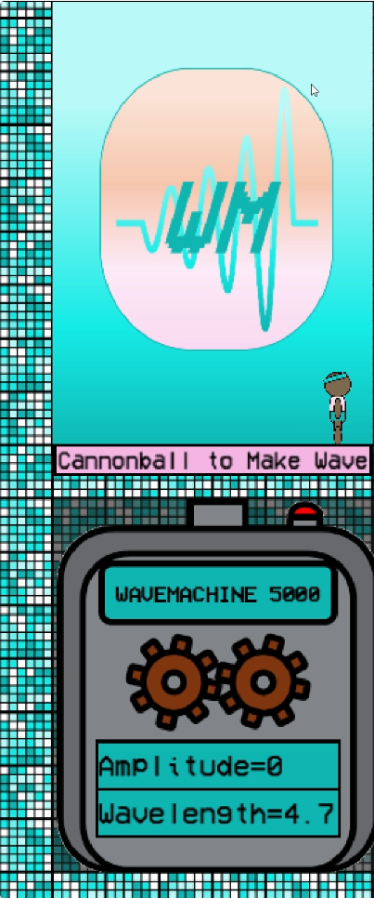
The Wavelength (distance between peaks of the wave) is determined by your horizontal position (Left and Right Arrow Keys).
More Left = Smaller Wavelength
More Right = Larger Wavelength
Wavelength Displayed Here

Slide 51
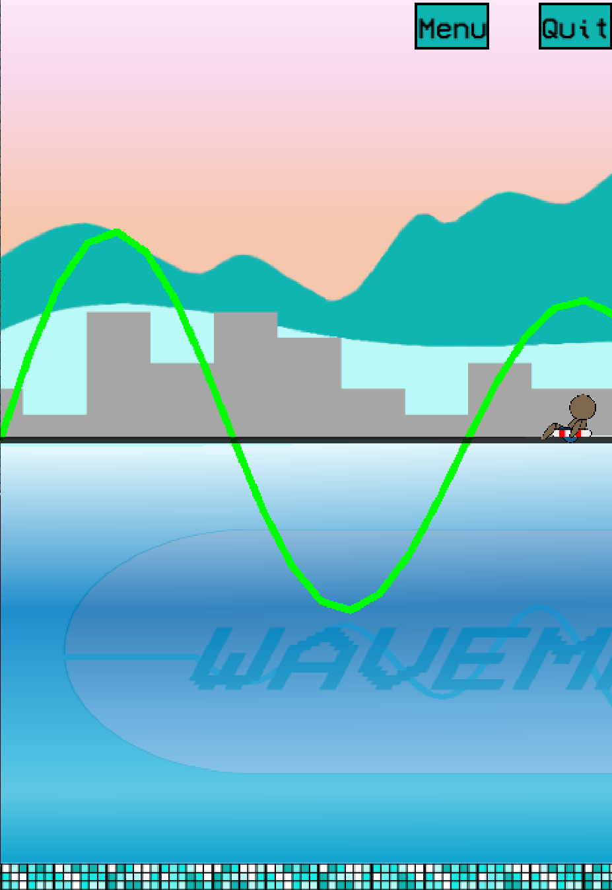
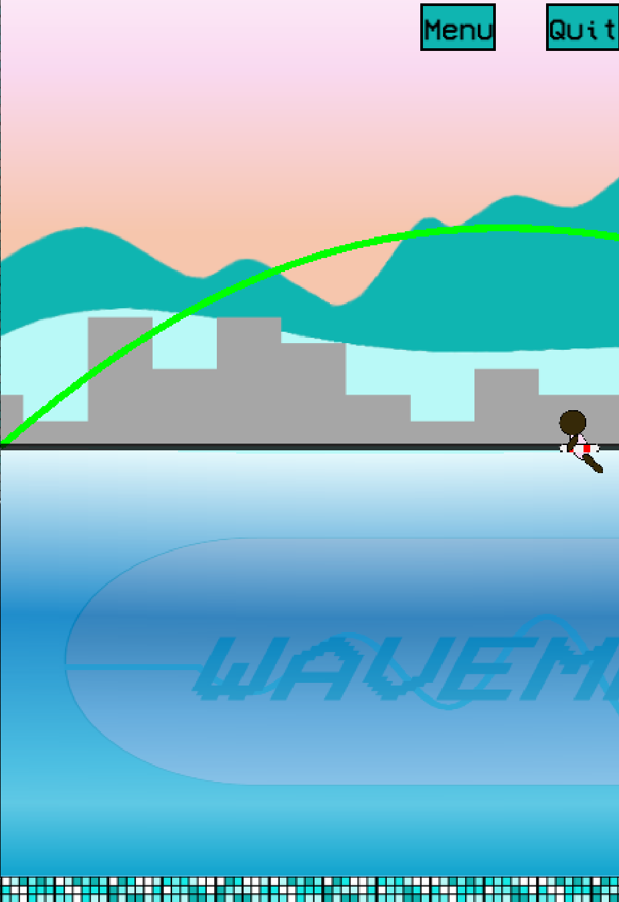
On the left is an example of a lower wavelength, while an example of a larger wavelength can be seen on the right
Smaller Wavelength
Larger Wavelength

Slide 52
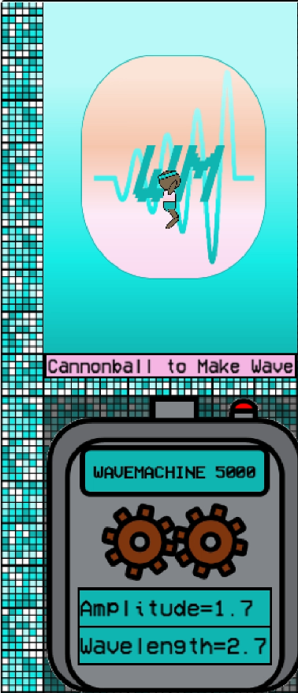
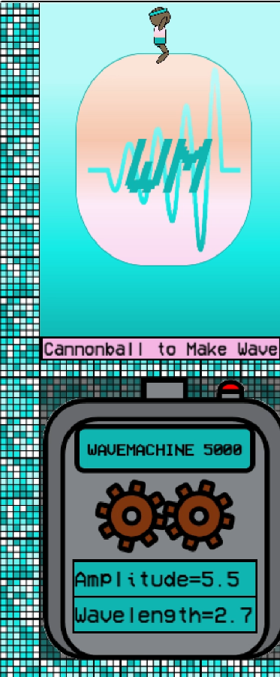
The Amplitude (height of the wave) is determined by your height when you start your cannonball.
Less Height= Smaller Amplitude
More Height= Larger Amplitude
More Left = Smaller Wavelength
Amplitude Displayed Here

Slide 53
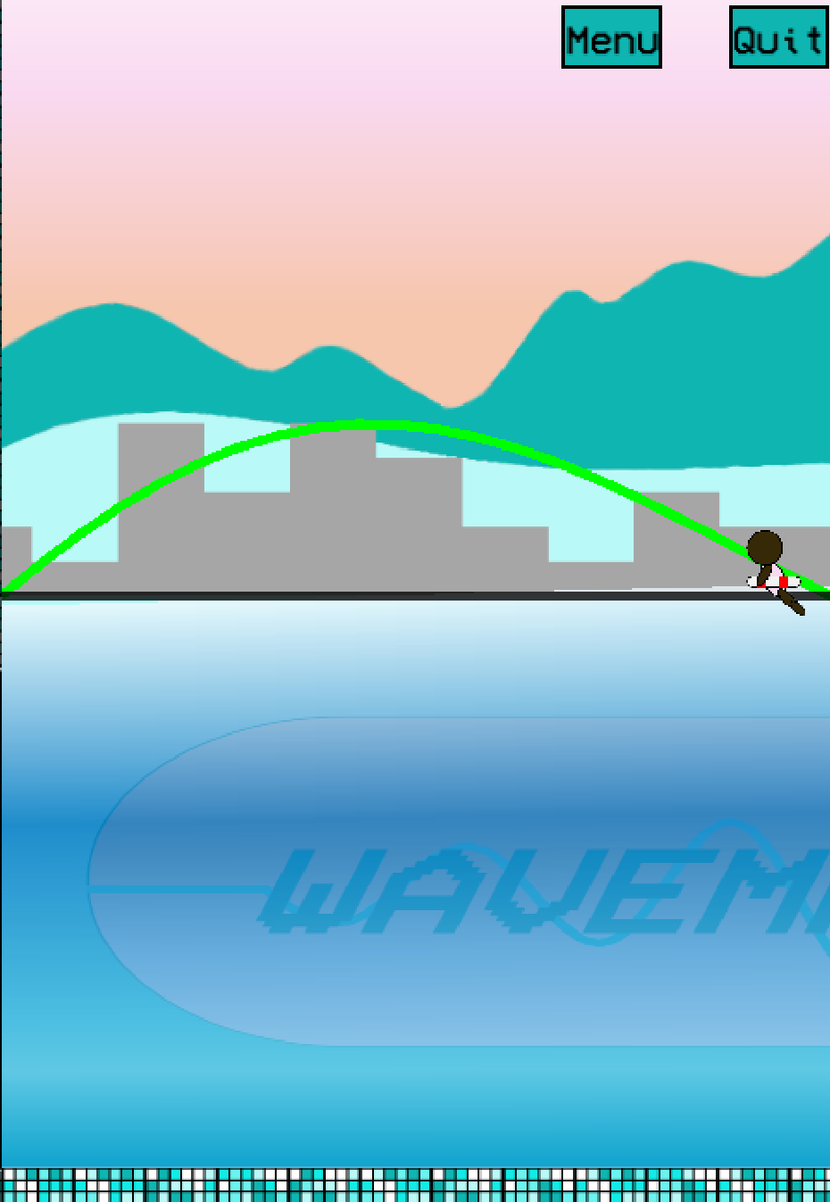
On the left is an example of a larger amplitude, while an example of a smaller amplitude can be seen on the right
Smaller
Amplitude
Larger
Amplitude

Slide 54
More left = the smaller Wavelength (meaning there will be more peaks in the wave and a lower Vibes level); more right =larger Wavelength (meaning there will be fewer, meaning a higher Vibes level). Higher cannonball height =the higher Amplitude (which means a higher Excitement level for the pool-goer). The closer you match the Wavelength and Amplitude to the Vibes and Excitement of the pool-goer, the higher your score!
Remember W.A.V.E.S:
Wavelength = Vibes
Amplitude = Excitement

Slide 55
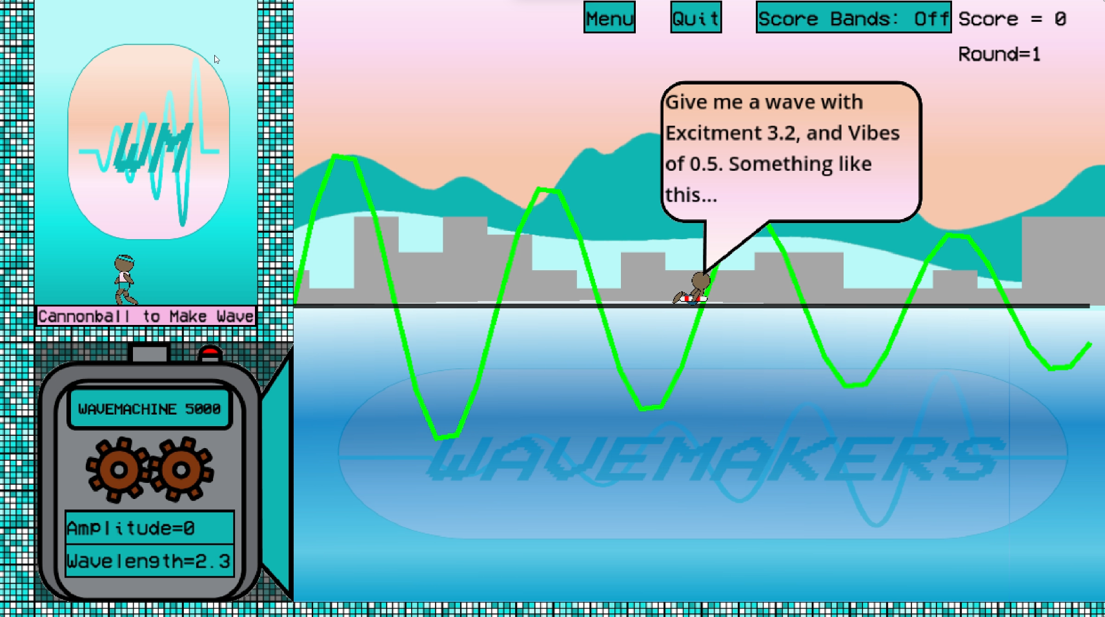
Green Line = Outline of Requested Wave
Wave Vibes and Excitement levels requested
To help you make the optimal wave, the pool-goer will tell you the Vibes and Excitement levels of the wave they want, and they will show you what that should look like with a green wave line.

Slide 56
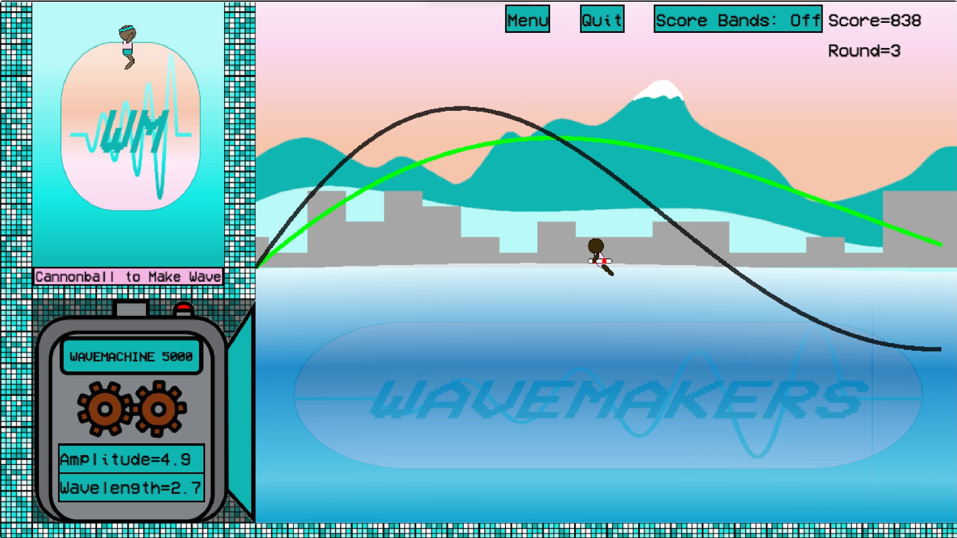
Black Line = Live-Updated Outline of potential output Wave
Due to your skills as a Wavemaker, you will be able to visualize the wave you are about to make, shown by a black line that will live-update based on your Wavelength and Amplitude.

Slide 57
There are 6 different pool-goers, each having different wave preferences
One game of Wavemakers consists of 6 rounds, with your score being calculated across 6 rounds.
Try to get the best score in all 6 rounds to see if you can reach the Wavemaster Ranking!

